Slide 1

Team Arangur
Project Topic: Determinants of Food Security in Ethiopia
Priyanandana Varma
Priyanka Thakkar
Sharang Biradar
Snehal Kasturey
Thorsteinn Nielsen

Slide 2
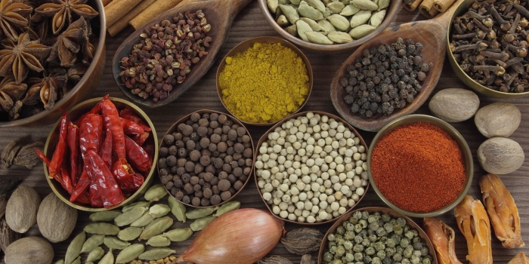
What is Food Security?
“When all people, at all times, have physical and ecological access to sufficient, safe and nutritious food to meet their dietary needs and food preferences for an active and healthy life”
Notes:
About 10% of Ethiopia’s citizens are chronically food insecure and this figure rises to more than 15% during frequent drought years; 2.7 million People require emergency food assistance in 2014 and 238,761 children require treatment for severe and acute malnutrition in 2014.
Today, Ethiopia faces high levels of food insecurity, ranking as one of the hungriest countries in the world,^{[2]} with an estimated 5.2 million people needing food assistance in 2010.^{[3]}
agriculture in Ethiopia is the largest contributor to economic growth and the economy's most important sector
The deteriorating situation of food security in Ethiopia is caused by population pressure, drought, shortage of farmland, lack of oxen, deterioration of food production capacity, outbreak of plant and animal disease, poor soil fertility, frost attack, shortage of cash income, poor farming technologies, weak extension services, high labor wastage, poor social and infrastructural facility and pre and post harvest crop loss.
CPI is increasing.. trade is getting worse
Today, Ethiopia faces high levels of food insecurity, ranking as one of the hungriest countries in the world,^{[2]} with an estimated 5.2 million people needing food assistance in 2010.^{[3]}

Slide 3
Problem Statement
Currently there is no defined indicator on how food security in Ethiopia has been affected by interventions and actions made by the Ethiopian government post 2000.
Notes:
While we were reading about ethiopia and the challenges that it is facing as a country,
Among these are the Sustainable Development and Poverty Reduction Program (2000/01 – 2004/05), and the Plan for Accelerated and Sustained Development to End Poverty (2005/06 – 2009/10).

Slide 4
Creating a food security index
Our food security index will give us information on how Ethiopia is progressing towards food security, specifically in comparison to countries with similar characteristics in Sub-Saharan Africa.

Slide 5




Methodology-Data Gathering
We have considered the following metrics
Contribution of Agriculture to total GDP
Land productivity
Monetary
Trade & Foreign Investments
Production Cost
Household Food Consumption
Food Prices/Inflation
Corruption
Notes:
While considering a country’s food security, it is important to consider many factors
Contribution of agriculture to total GDP
Agriculture value added (% of GDP)
Land productivity
Agricultural land usage ratio
Food production index (2004-2006 = 100)
Trade
Trade Freedom Index
Trade Freedom Index, Score
Foreign Direct Investment (% GDP)
Exports and imports
Production cost
Food Production index
Clean water (% of population with access)
Clean Water (% of population with access), Score
Corruption Index (0-lowest,100-Highest)
Corruption Index (0-lowest,100-Highest)
Rural Transporation Infrastructure to Total (%)
Rural Transporation Infrastructure to Total, Score
GDP PPP (USD)
GDP PPP, Score
Poverty gap at $3.10 a day (2011 PPP) (%)
Poverty gap at $3.10 a day (2011 PPP) (%), Score
Prevalence of undernourishment (% of population)
Prevalence of undernourishment (% of population), Score
Agricultural land usage ratio, Score
Agriculture Value Added (% of GDP)
Agriculture Value Added (% of GDP), Score
Food production index (2004-2006 = 100)
Food production index (2004-2006 = 100), Score
Household food expenditure as a share of total household expenditure
Household food expenditure as a share of total household expenditure, Score
Depth of the food
deficit
(kilocalories per
person per day)
Depth of the food deficit (kilocalories per person per day), Score
CPI
CPI, Score
Trade Freedom Index
Trade Freedom Index, Score
Foreign Direct Investment (% GDP)
FDI (%GDP) Score

Slide 6


Global Food Security Index

Slide 7
Understanding Food Security
Looking at economical, socio-economic and agricultural factors.
Usually categorized into three categories. Food affordability, food availability and quality & safety.
No specific standard or official measure on food security. Factors analyzed collectively.

Slide 8
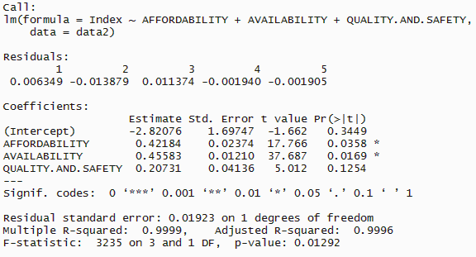
Finding significant factors in the Global Food Security Index

Slide 9
The Ethiopian Agricultural Transformation Agency (ATA) and GTP
ATA established by the Ethiopian government in 2010
Umbrella for multiple programs such as, the Sustainable Development and Poverty Reduction Program (2000/01 – 2004/05), and the Plan for Accelerated and Sustained Development to End Poverty (2005/06 – 2009/10).
GTP (Growth and Transformation Plan) 2010/11-2014/15 as extension.
GTP Objectives:
1. Ensure food security and support the food industry through increasing crop production
2. Increase crop production by increasing cultivable agricultural land
3. Improve agricultural production and productivity by improving extension service utilization and agricultural inputs
4. Improve livestock production & productivity
5. Encourage private sector investment in agriculture & increase agricultural product exports
6. Decrease the population living below poverty line
We have chosen to analyze factors that directly relate to those objectives.

Slide 10

Challenges
Collecting data from multiple separate sources
Deal with the varying time period for each dataset
Determine the missing values
Decide on the weights contributing to Food Security Index

Slide 11
Established factors
X₁: Clean water (% of population with access)
X₂: Corruption Index (0-lowest, 100-highest)
X₃: Rural Transportation Infrastructure to Total (%)
X₄: GDP PPP (USD)
X₅: Poverty Gap at $3.10 a Day (2011 PPP) (%)
X₆: Prevalence of Undernourishment (% of population)
X₇: Agricultural Land Usage Ratio
X₈: Agriculture, Value Added (% of GDP)
X₉: Food Production Index (2004-2006 = 100)
X₁₀: Household Food Expenditure as a Share of Total Household Expenditure
X₁₁: Depth of Food Deficit (kcal/person/day)
X₁₂: CPI (Consumer Price Index)
X₁₃: Trade Freedom Index (0-lowest, 100-highest)
X₁₄: Foreign Direct Investment (% GDP)

Slide 12
Scoring the factors
All factors received an individual score from 0 (worst) – 100 (best)
Four approaches:
1. Global Performance
2. Sub-Saharan Performance
3. Values Directly to Scores
4. Mix

Slide 13
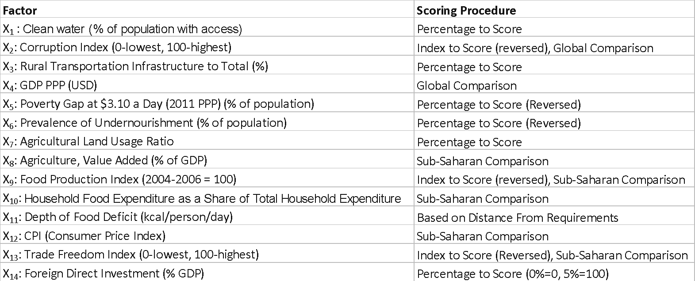
Factors and their respective scoring methods

Slide 14
Weighing Model
Weighing factors accordingly is very important when making an index but indexes are usually based on some sort of a weighted average.
Our method is based on equal weights that are adjusted for highly correlating and therefore dominating factors
Utilizes a correlation matrix

Slide 15
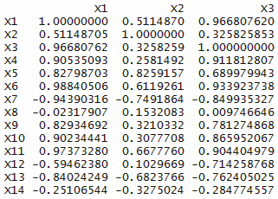
Correlation Matrix

Slide 16
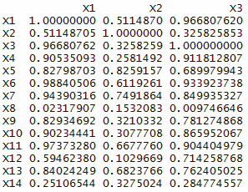
Absolute Value Correlation Matrix

Slide 17
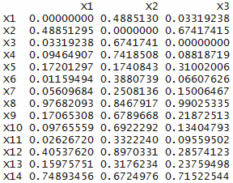
Reverse Value Matrix (Pairwise Weight Comparison Matrix)

Slide 18
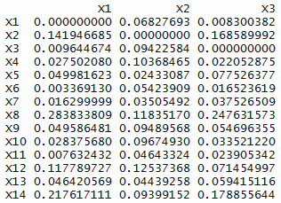
Normalized Matrix

Slide 19
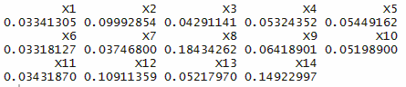
Weights
Highest weights
X8: Agriculture, Value Added (% of GDP)
X14: Foreign Direct Investment (% of GDP)
X12: CPI (Consumer Price Index)

Slide 20
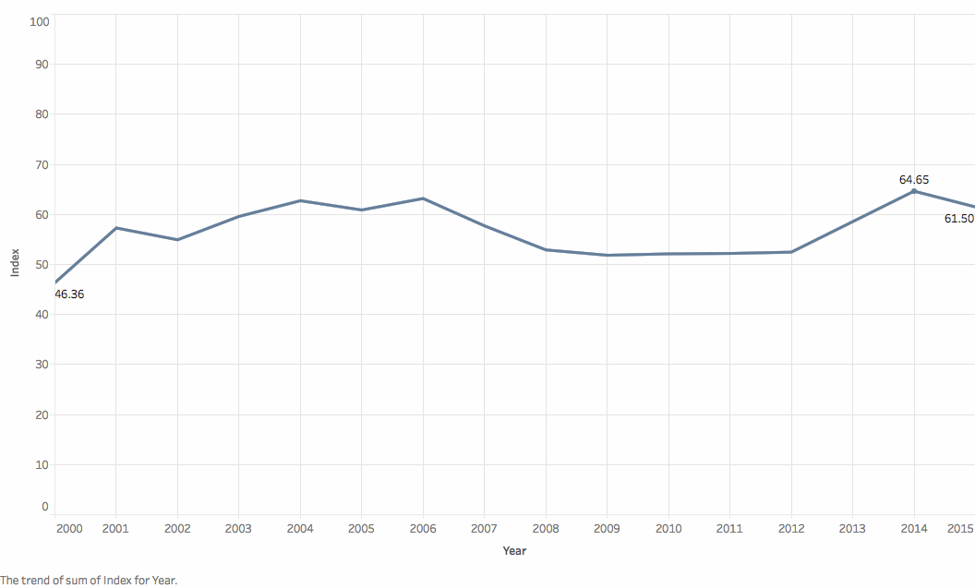
FOOD SECURITY INDEX

Slide 21
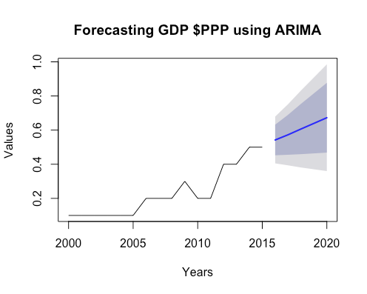
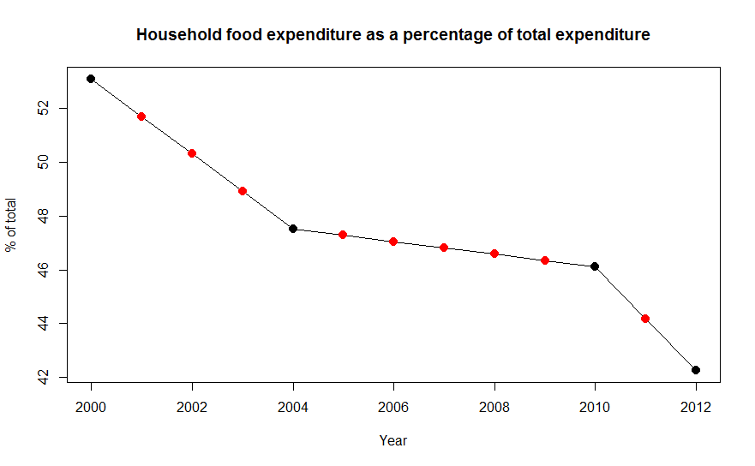
Determining the missing values
Linear regression and ARIMA forecasting
Notes:
HoltWinters Seasonal smoothing could not be used as there was no seasonality observed in the dataset. .

Slide 22
Results
Deliverable 1
Factors majorly impacting food security..
Agriculture Value Added
Consumer Price Index
Corruption Index
Foreign Direct Investment

Slide 23
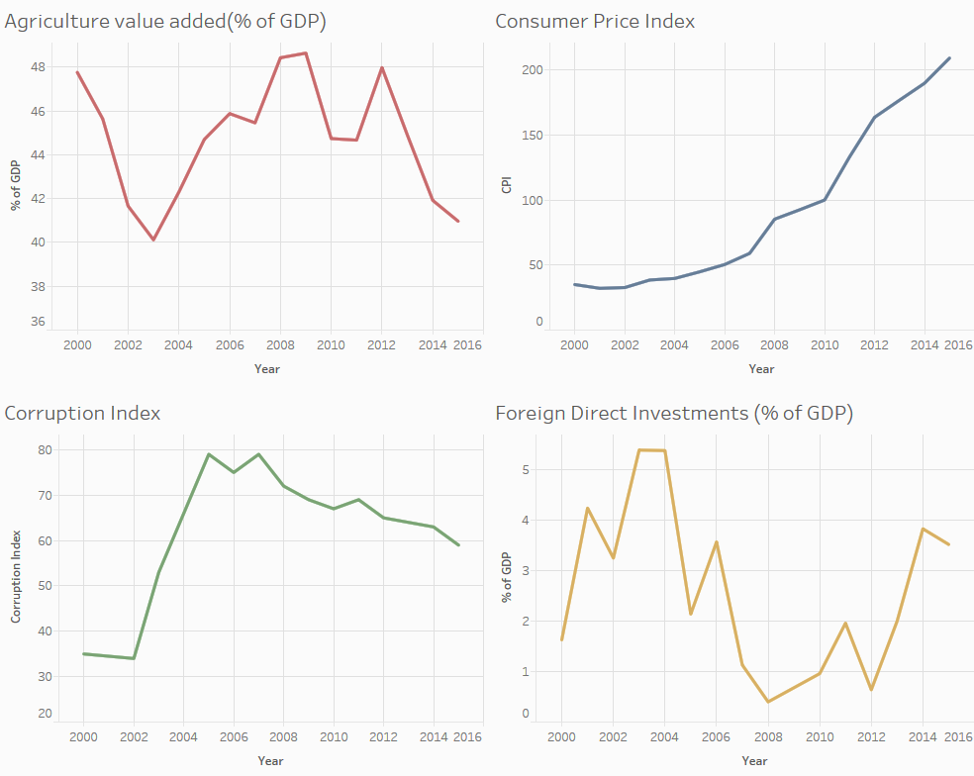
Trends of top 4 factors contributing to Food Security Index
Notes:
There was a drought in 2003
In 2003 there was a drought which affected the agriculture output which resulted in reducing the

Slide 24
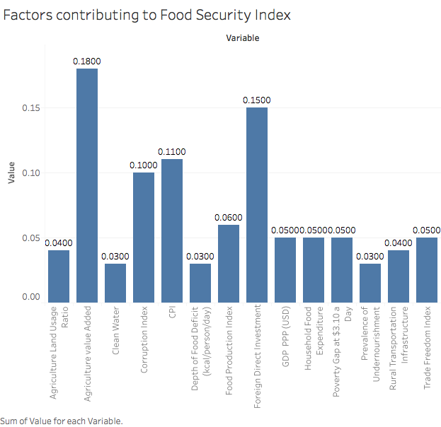

Slide 25
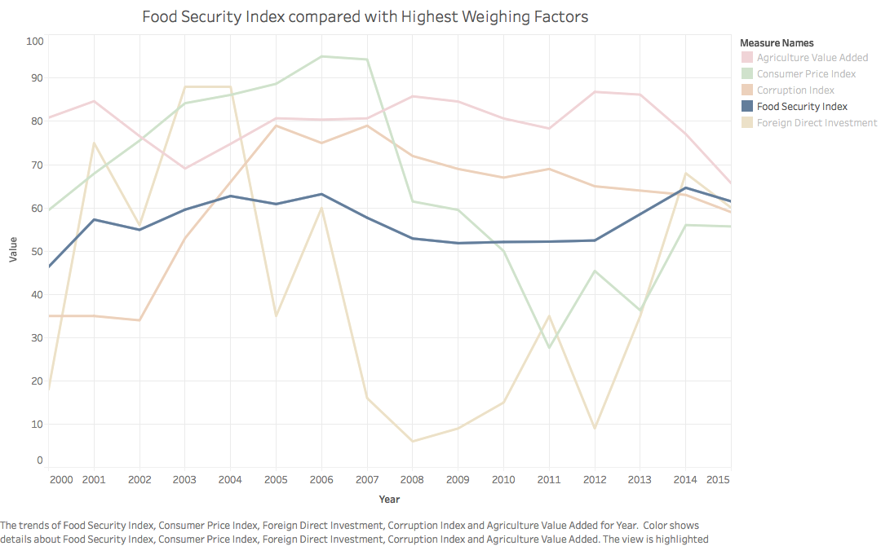
Deliverable 2: Food Security Index from 2000 to 2016
Notes:
Challenges to Food Security • Increasing food prices • Climate change • GeneGcally engineered crops • CompeGGon for land • Limited research support • Global populaGon increase
Agriculture value added is the net output of the agriculture sector, including forestry, hunting and fishing, and cultivation of crops and livestock production, after adding up all outputs and subtracting intermediate inputs. Deductions for depreciation of fabricated assets and depletion and degradation of natural resources are not included in the calculation.
Challenges to Value-Added Agriculture • SubsidizaGon of the wrong products (e.g. processed foods) • SubsidizaGon of wrong pracGces (e.g. use of fossil fuels and toxic pesGcides). it relates to the economic growth.
2. consumer price index (CPI), which accounts for changes in the prices paid for food products by consumers
It is based on the premise that, consumer spending of households is often influenced by price elasticity (changes in food prices) with a consequence on household incomes. The study found out that, food price inflation has increased in many Sub-Saharan African countries; pushing up CPIs with ripple effects on households and on the macro economy. This has a direct consequence on the already weakened household purchasing power thus exposing these households to food insecurity.
Studies on CPI in developing countries have mostly considered its impact on food prices with less emphasis on its consequences for food security.
Camara (2011) found that, changes in food prices are driven by variations in cereal prices with a consequence for household real incomes. This study concluded that, households allocated a greater portion of their budget to food especially rice instead on millet, sorghum or maize. These caused significant nutrient and micronutrient deficiencies such as that of vitamin A, vitamin C, iron and calcium.
3. according to Transparency International, corruption substitutes "competitive" bribery for open competition. It retards private sector development and discourages investments. the implementation of sustainable food programs or other projects, the destructive nature of corruption manifests itself in that: (i) decisions are taken not for public benefit, and (ii) high cost, complex and prestigious projects invariably favored over cost-efficient, community-based initiatives using appropriate technology.
There are currently no studies exploring corruption and food security, on a global scale, with internationally validated tools.
Food security and political stability are often linked, although the relationship is complicated and not necessarily direct or causal. However, evidence suggests that food security can be upset by a lack of political or social stability. Similarly, the lack of food security resulting from a sudden jolt (i.e. international embargo, poor climate) can lead to political instability. "Food riots", when they occur, are often instigated by urban residents; poorer rural residents rarely have a political voice.
4. FOOD ACCESS AND AVAILABILITY CHANNEL:Improved skills that put workers in a better bargaining position Positive externalities more evenly distributed, thus reaching the poor. Higher employment and wages
Development and growth : Diversified, better and more accessible services Positive externalities for upstream and downstream industries Technology and know-how spillovers. the relation doesnt seem to be direct because Governments in developing countries often pursued agricultural policies focused onchemical-dependent technologies due to multinational involvements in agricultural projects. This leads toreplacement of crop rotation and recycling of organic matter with the high-intensity use of pesticides and syntheticfertilisers. Negative effect on wages and labor laws Shifts use of land from subsistence agriculture to commercial f

Slide 26
‘Good to have’ Deliverable
Suggestions for sub-saharan countries.
Reduction in corruption can increase food security.
Increase in Agricultural infrastructure boosts food security
Dealing with Total household income
Notes:
Reduction in corruption can increase food security
Malawi has experienced an improvement in score due to the greater political stability despite steady food price inflation. this can be taken as example for Madagascar and Mozambique which has greatest deterioration in overall food security in the region owing to political instability and ineffective government.
Increase in Agricultural infrastructure boosts food security
South Africa and Botswana have by far the highest overall food security score owing to well-developed agricultural infrastructures by regional standards. something DRC, Chad and Madagascar which are the worst performing countries can work on.
Dealing with Total household income
The increase in affordability is largely linked to rapid economic growth and rising household incomes, which is main driver for Uganda’s improvement.
Reduction in corruption can increase food security
Food price inflation in Malawi has increased steadily over the years. In the start of the year there’s sharp rise in food price inflation as supplies are stretched, and then a steep fall once local cereal harvests were collected in May. But the country has experienced an improvement in score due to the greater political stability.
On the contrary, Madagascar recorded the greatest deterioration in overall food security in the region owing to political instability and insecurity. Weakened government effectiveness and public institutions have seen a deterioration in nutritional standards, while underinvestment in agricultural infrastructure and low household income growth have contributed to the deterioration in the country’s overall food security score.
Mozambique, where food security has suffered from limited and ineffective government intervention in the agricultural sector, which has seen productivity stagnate and nutritional standards fall.
Increase in Agricultural infrastructure boosts food security
South Africa and Botswana have by far the highest overall food security score. Botswana has well-developed agricultural infrastructures by regional standards, which includes adequate food storage that helps reduce food loss. DRC, Chad and Madagascar are the worst performing countries as Agricultural infrastructure is very weak following years of underinvestment.
Dealing with Total household income
Uganda has the most improved overall score in the region, driven reduction in agricultural volatility and a decrease in the share of household income spent on food are the main drivers of Uganda’s improvement
The increase in affordability is largely linked to rapid economic growth and rising household incomes, as a result of which most countries in the region have seen reductions in the proportion of the population under the national poverty line and the percentage of household income spent on food. strciking better deals while doing deals for foreign investment.

Slide 27
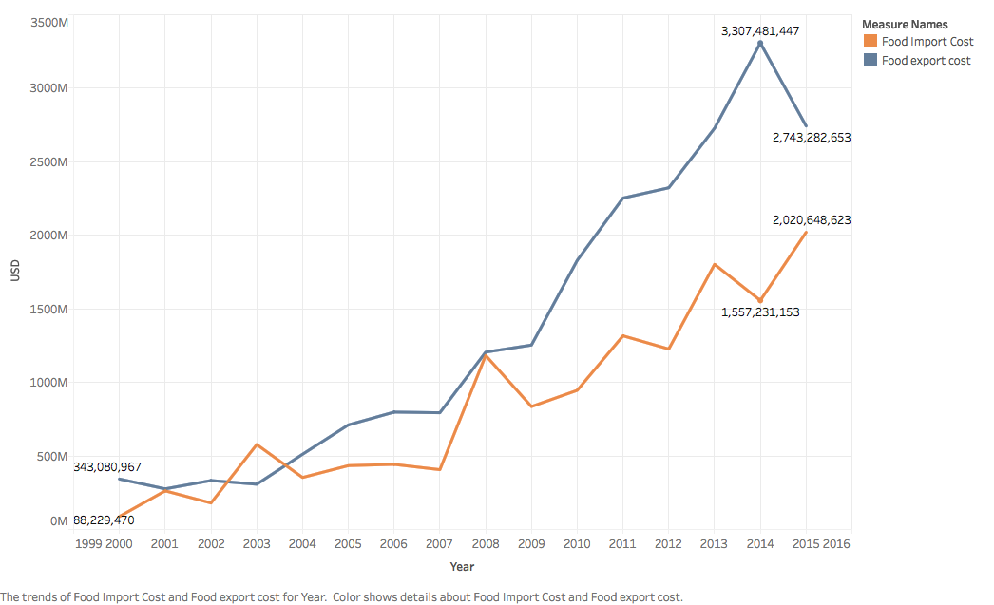
Food Export/Import
Notes:
Net Exporting country so increase in trade decreases food security. trade freedom is scored on that bases.

Slide 28


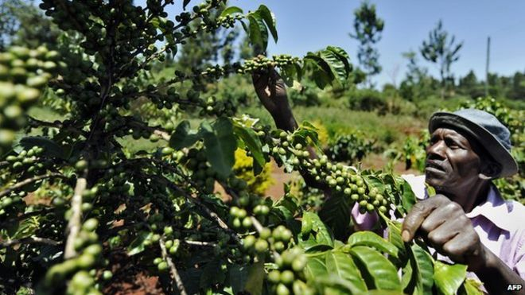
Conclusion
Regulations on corruption to encourage Foreign Direct Investment
Don’t make trade agreements in blind faith
As agriculture is one of the biggest contributors to GDP, FDI investment on Agricultural R&D is encouraged
Notes:
UN, Increasing export has a negative effect on food security.

Slide 29
Business Implications
A marketable index that governments and other organizations can use to analyze food security and make informed decisions on where to focus their efforts to achieve their goal of promoting food security.
Our index is built on data post 2000 but The Global Food Security Index was introduced in 2012 so it can be used to analyze the results of interventions and actions implemented more than 4 years ago.
Our Index is more accurate for Sub-Saharan countries than the Global Food Security Index since the scoring model is partially based on Sub-Saharan Performance comparison.
Notes:
our index is not global and the scoring is done based on the sub-saharan countries only.

Slide 30

Q&A

Slide 31
References
http://www.davidpublishing.com/davidpublishing/Upfile/10/10/2013/2013101068414745.pdf
http://indecs.eu/2012/indecs2012-pp159-173.pdf
http://www.bdresearch.org/home/attachments/article/nArt/324.pdf
http://www.ajol.info/index.php/ajfand/article/view/50072/36391
http://www.fao.org/3/a-i5738e.pdf
http://www.ata.gov.et/

